Slide 1

Board of Trustees Progress Report
Core Theme • Equity in Community
June 13,
2023

Slide 2
Core Theme •
Equity in Community
Indicator | Threshold
1.A. Index of Community College Survey of Student Engagement (CCSSE) and Noel-Levitz Survey of Student Satisfaction questions related to diversity and belonging | Index score will equal or exceed index score of similar-sized colleges
1.B. SVC-specific questions related to diversity/belonging included in CCSSE & Noel-Levitz surveys | Students will report positive response to SVC-specific questions related to diversity and belonging
1.C. Employee responses to biennial administration of College Vision Survey | Employees will report positive responses to questions regarding Guiding Principles and selected questions regarding diversity and belonging
Notes:
Spring 2023 we are reporting on 1.C. Employees
In place of the Vision survey we will be using the Diversity, Equity and Inclusion Assessment we administered in Spring 2022. A year ago.

Slide 3
Core Theme •
Equity in Community
Indicator | Threshold
2.A College partner evaluation in educational pathway efforts | Select partners will report overall positive evaluation
2.B. College partner evaluation in Economic Development & Workforce Training efforts | Select partners will report overall positive evaluation
2.C. College partner evaluation in Diversity, Equity and Inclusion efforts | Select partners will report overall positive evaluation
2.D. College partner evaluation in Civic Life efforts | Select partners will report overall positive evaluation

Slide 4
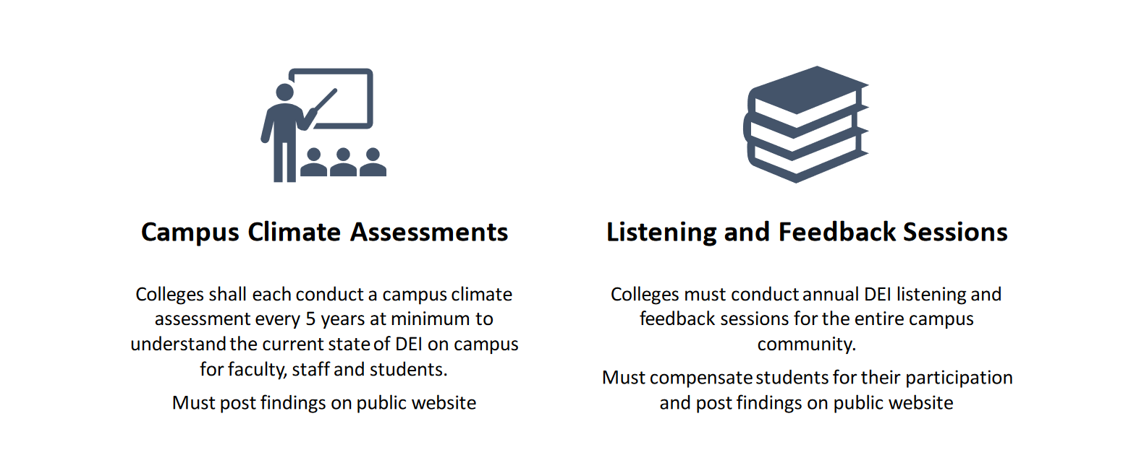
SB 5227: Diversity in Higher Education

Slide 5
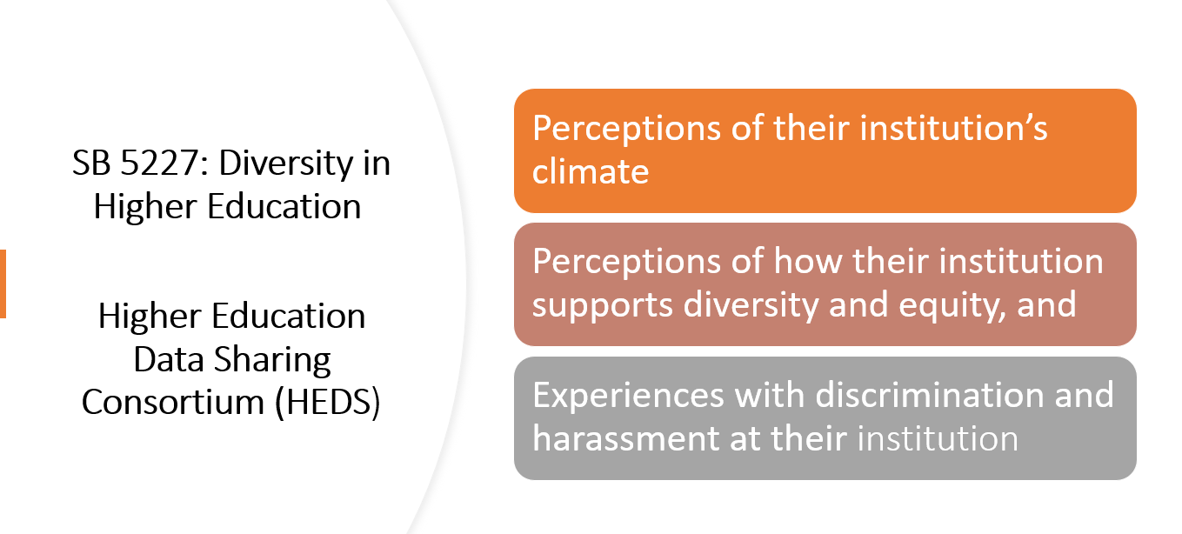
HEDS Survey

Slide 6
Why HEDS is Important
Extent to which our campus climate supports diversity and equity efforts
Inform and improve support, policies, and practices
Prevent or respond to discrimination and harassment

Slide 7
Measures
Discrimination/Harassment
Overall Campus Climate and Sense of Belonging
Institutional Support

Slide 8
1. Discrimination/Harassment
Overall, SVC employees were no more or less likely than their national peers to report experiencing negative comments, discrimination, and/or harassment.

Slide 10
1. Discrimination/Harassment
Breakdown
Compared to their national peers at 2-year institutions:
  Faculty were significantly more likely to report discrimination or harassment
  Also, employees who identify as more than one race, employees who identify as female, and those with long term disabilities were more likely to report experiencing discrimination ot harassment
  Employees who identify as Latinx were less likely to report discrimination or harassment

Slide 11
2. Overall Campus Climate & Sense of Belonging
In comparison with other public two-year institutions, SVC employees:
  Were less satisfied with the overall campus climate
  Reported a low(er) sense of belonging
  Were significantly less likely to report that the campus was free from tensions

Slide 12
Community Partnership –
Maestros para el Pueblo
The Maestros Para el Pueblo partnership has produced a variety of impacts that promote equitable and thriving communities.
  “It is clear that the Maestros partnership is not only impacting the existing organizational partners, but the larger community as well.”
  “A young woman was recently hired at MVSD. She focused on the relationships she formed at SVC with Maestros peers, which became her community within the College.”
  “There is incredible value in hearing students’ voices, and the Maestros program helps us be more responsive to the unique needs of our students.”
  “The partnership fits with WWU’s vision of diversifying faculty.”

Slide 14
2. Campus Climate & Sense of Belonging Breakdown
  SVC Faculty were significantly less satisfied with the campus climate and less likely to experience a sense of belonging than their national peers
  In addition, female identified employees, employees with disabilities, and LGBTQ+ employees were less satisfied with the campus climate and their sense of belonging compared to national peers
  Political affiliation, religion, and ELA individuals generated the most discomfort in working interactions

Slide 15
3. Institutional Support for Diversity, Equity and Inclusion
Overall SVC employees rated institutional support for DEI significantly lower than national peers:
  Faculty, Latinx employees, and employees with a disability rated institutional support for Diversity, Equity and Inclusion significantly lower than national peers
  Employees who identified as LGBTQ+, women, and white also rated institutional support for Diversity, Equity and Inclusion lower than national peers

Slide 16
Listening and Sharing Sessions
Cabinet Plus Retreat
Faculty Union Leadership
Equity and Social Justice Committee
Shared at monthly president’s meetings
Future Plans (2023-2024)
  Listening session and focus groups with targeted student and employee demographics e.g.

Slide 17

Indicator Scorecard
Employees will report positive responses to questions regarding Guiding Principles and selected questions regarding diversity and belonging
.

