Slide 1
Student Completion Data and Equity Gaps
Fall 2024 SVC Cabinet
Operational Planning
Gabriel Mast, VP of Planning and Institutional Effectiveness

Slide 2
Completion Data
Data Descriptions:
Data are averaged from 3 cohorts of degree seeking students: 2022, 2023, & 2024
Non degree seeking students are excluded (e.g. Running Start, BEdA, CiHS, Apprentice, Community Ed, etc)
Completion is defined as successful completion of a degree OR certificate OR transfer to a 4-year institution within 6 months of cohort completion date
Issues with the data:
Degree program assignment, part-time vs full time, pre-college identification

Slide 3
Completion Data Trends
Overall, completion is improving but not very fast

Slide 4
Completion trends
In general, the following variables predict lowered completion likelihood (in order of impact). Students who:
  Attend part-time
  Identify as Hispanic/Latino
  Start below college level
  Older students*
  Students who identify as male*
  Students who identify as Black, Pacific Islander, and Native American*

Slide 6
Disaggregation: Academic Transfer
The (negative) effect of identifying as Hispanic/Latino is greater (11% vs 4%) greater for Academic Transfer Students
Older students are less likely to complete. This effect is compounded (enhanced) for students who also identify as Hispanic Latino AND for students who identify as male

Slide 7
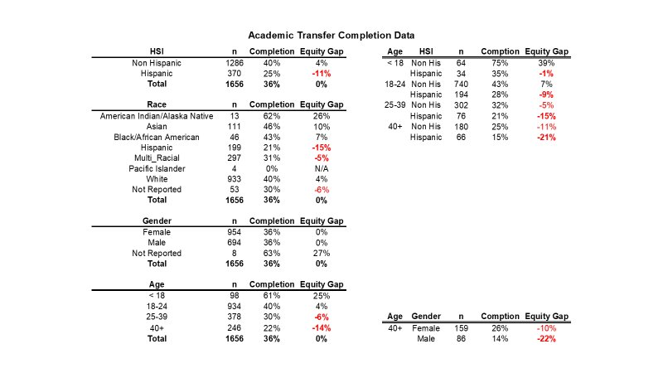

Slide 8
Disaggregation: Workforce
Workforce students who identify as Hispanic Latino still complete at lower rates than those who do not
In general, older workforce students do better than younger students
However, students who identify as male have lower completion rates and this effect is magnified by increased age. In other words, older female students are driving the positive age effect (RN students?)

Slide 9
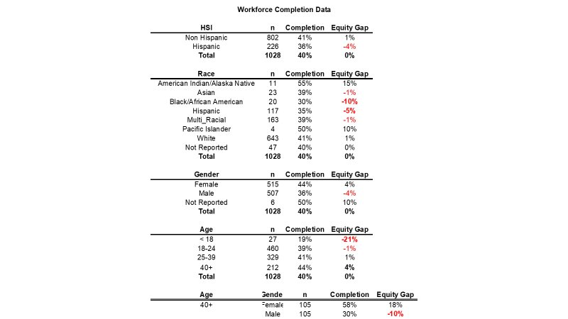

Slide 10
Disaggregation: Bachelor's Students
BAS students do better in terms of completion than associate degree students
Completion rates are improving. The BAS in Management students do very well, the BAS in ENVS do less well in terms of completion.
New programs coming on line and the BSCS (4 year program) will continue to influence these data in different ways.

Slide 11
