Slide 1




Slide 2


Slide 4


Text goes here

Slide 5


Slide 6
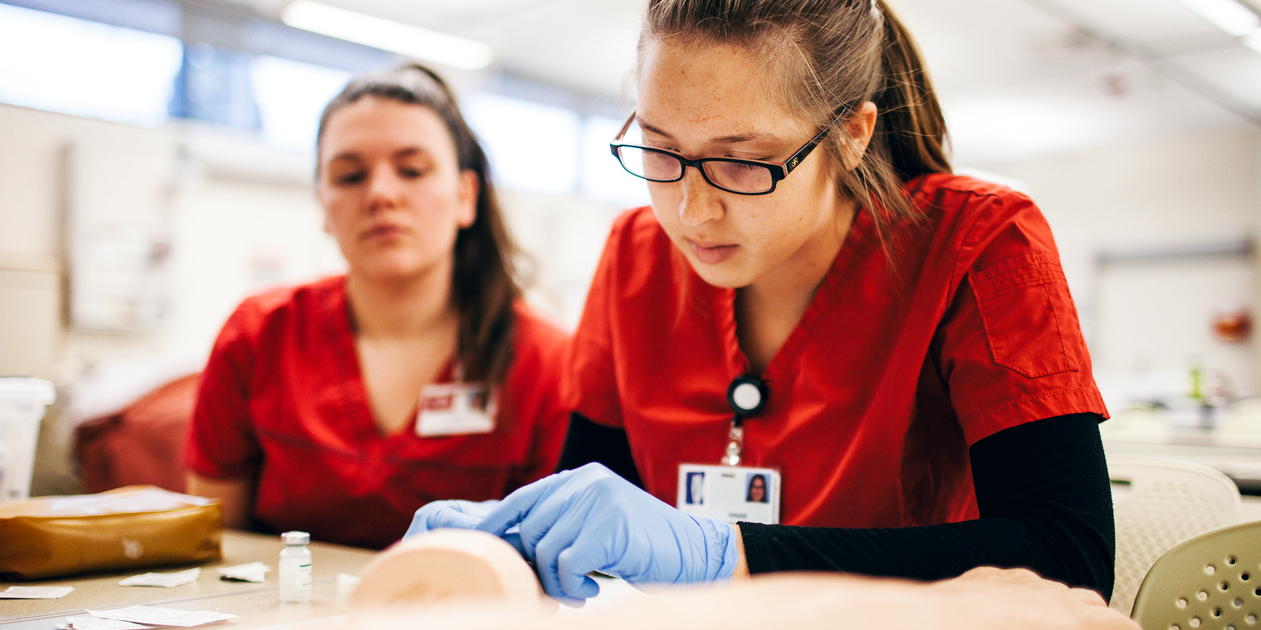

Text goes here

