Slide 4
Text goes here

Slide 6
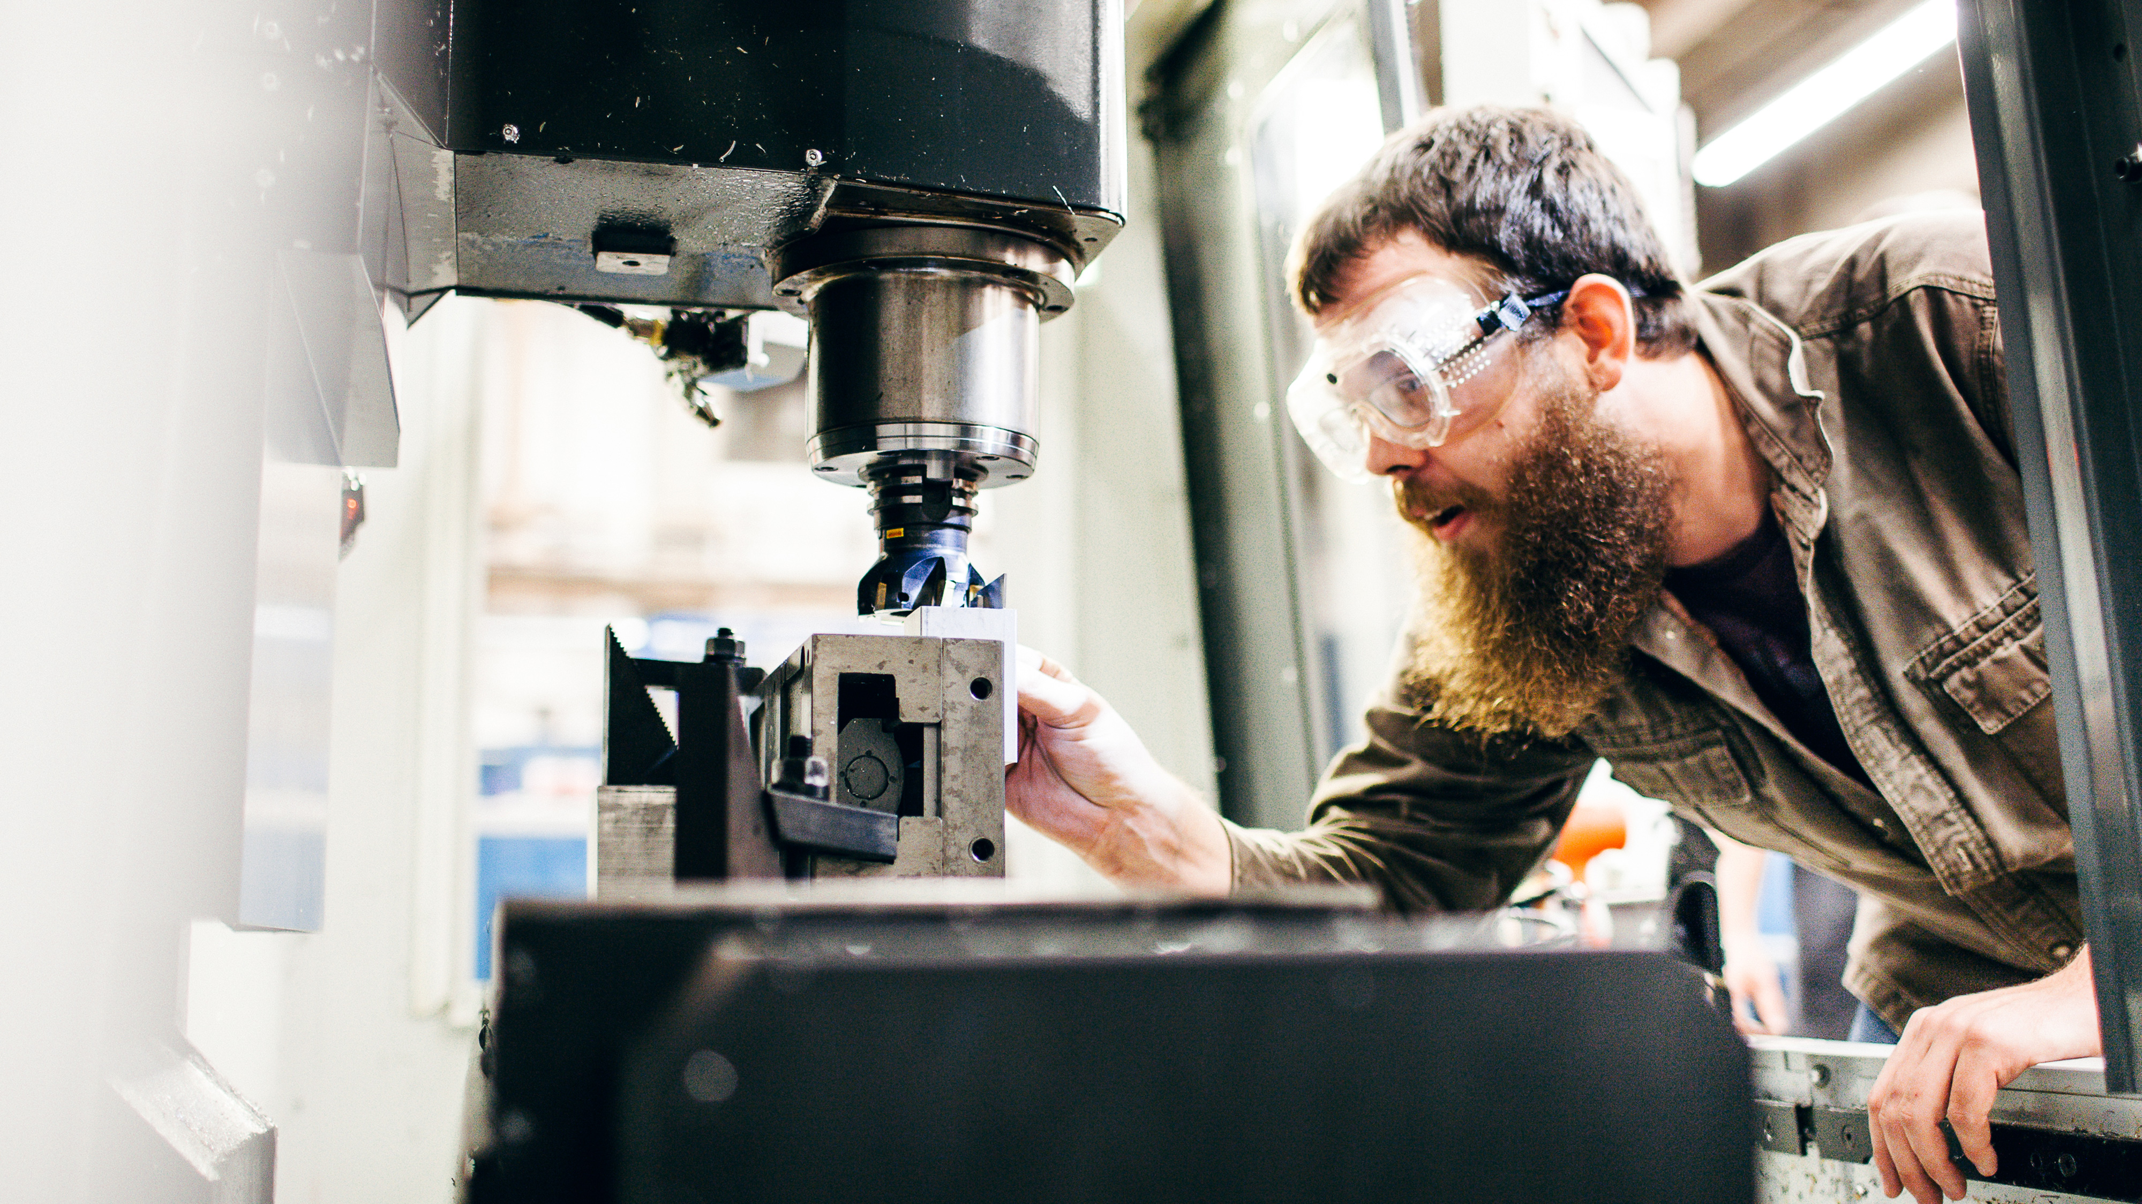
Text goes here

